Slide 1



Sentiment Analysis
Top Engineering Colleges
S.Harrshavardhann 221701018
K.I. Ganesh 221701015

Slide 2

Introduction
1.This project ranks top engineering colleges in Tamil Nadu based on user
sentiment analysis.
2.Users submit reviews, and the system analyzes sentiment to update
rankings.
3.The project is divided into Frontend, Backend, Sentiment Analysis, and
Deployment.
4.This presentation covers the completed frontend part (25%).

Slide 3

Frontend Technologies Used
HTML : Provides the basic structure of the webpage.
CSS : Used for styling, layout, and making the page visually
appealing
JavaScript: Adds interactivity, such as handling user input,
updating rankings, and performing sentiment
analysis

Slide 4
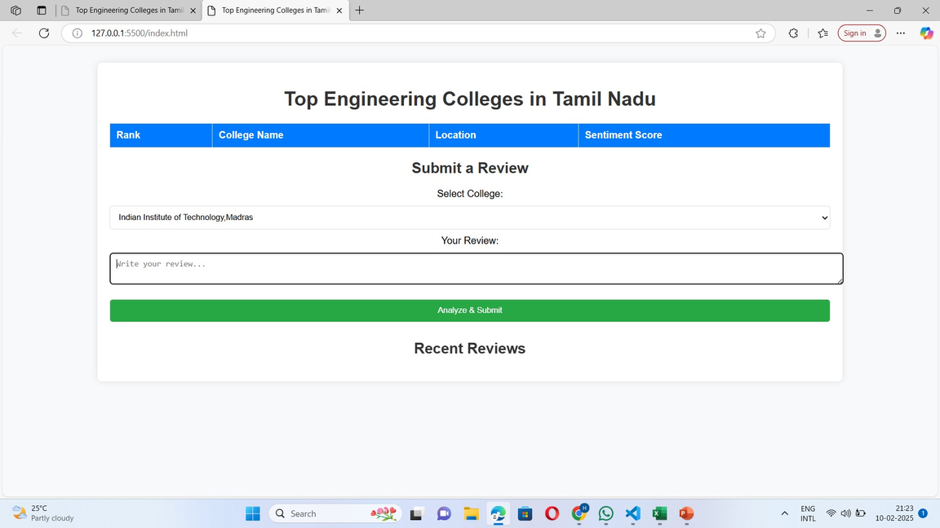
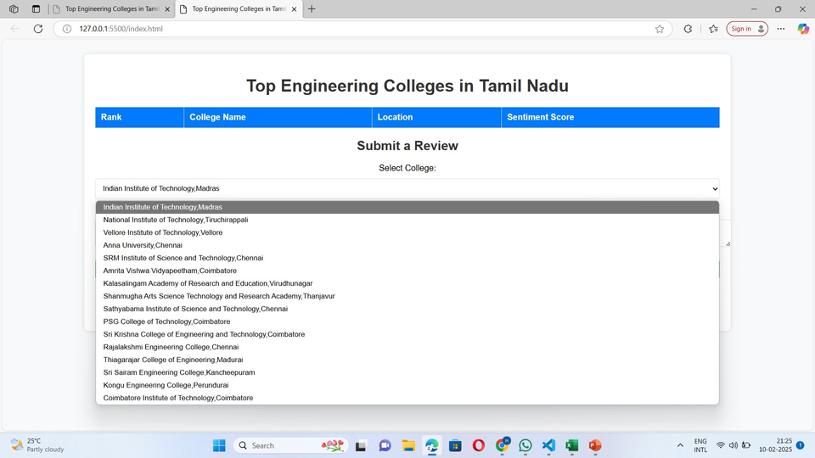
Website Structure (UI Design)
The website consists of:
A ranking table with Rank, College Name, Location, and Sentiment Score.
A review submission form with a dropdown to select a college and an input box for reviews.
A dynamic update feature where rankings adjust based on sentiment analysis.
The UI is clean and simple, as shown in the screenshots.
11
7

Slide 5
Sentiment Analysis in JavaScript
When a user submits a review, JavaScript processes the text. A word-based sentiment analysis is applied (e.g., detecting positive and negative words).
The system assigns a score (Positive, Neutral, or Negative).
Sentiment scores update dynamically, affecting the ranking system.
Future Enhancements:
1. Implement machine learning or NLP libraries (VADER, TensorFlow.js)
more accuracy.
2. Store past reviews in a database.

Slide 6
Dynamic Ranking & Review Submission
Colleges are ranked based on sentiment scores.
More positive reviews push a college higher in rank.
JavaScript updates rankings in real-time when a new review is submitted.
Workflow of Review Submission:
1. User selects a college from the dropdown.
2. User types a review in the text box.
3. Clicking 'Analyze & Submit' triggers sentiment analysis.
4. Sentiment score updates dynamically.
5. Recent reviews appear below.

Slide 7
Limitations & Future Enhancements
Current limitations:
- Basic sentiment analysis (word-based)
- No backend database integration
Future enhancements:
- Advanced NLP using Python (NLTK, VADER)
- Store and retrieve reviews using a database
- Deploy website for public access

Slide 8

Conclusion & Next Steps
Frontend (25%) is completed with UI and basic sentiment analysis.
The next step is to develop the backend and integrate a machine learning-based sentiment analysis.
Future work includes deploying the project and improving accuracy.

